Slide 1
20241021 F20 run S13 Step.5 low-temp abort

Slide 2
Discipline 1. 選定團隊 Form the Team

Slide 3
Discipline 2.描述問題及現況掌握Describe the Problem
(WHO detected the problem? WHAT is wrong? State the problem in terms of object and defect. WHERE the problem was first detected, describe location of the detection, lot #, WHEN and HOW it was detected)
What | F20 run S13 step5 low-temp abort C4 MW average:35Å (S13 target: 1800±180Å)
Where | oper5982
When | 10/21
Extent | Impact wafer : 1 lots/ 25 pcs
上貨時間 | 機台 | 程式 | LOC | Lot | Product | Route | Oper | Qty | EA
10/21/2024 9:31 | F20 |  | 1 | DUMMY |  |  | 0 | 0 | S100515
10/21/2024 9:31 | F20 |  | 2 | DUMMY |  |  | 0 | 0 | S100515
10/21/2024 9:31 | F20 |  | 3 | DUMMY |  |  | 0 | 0 | S100515
10/21/2024 9:31 | F20 |  | 4 | DUMMY |  |  | 0 | 0 | S100515
10/21/2024 9:31 | F20 | F20S13 | 5 | 24393080 | SA8119001 FF | E056FI | 5982 | 25 | S100515
10/21/2024 9:31 | F20 |  | 6 | DUMMY |  |  | 0 | 0 | S100515

Slide 4
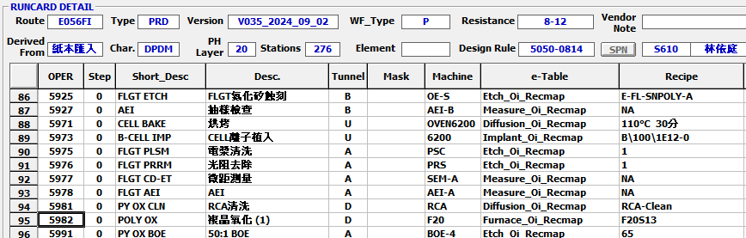
Run cards at impact station
將有問題的站點前後 run cards 貼上
E056FI-op5982

Slide 5
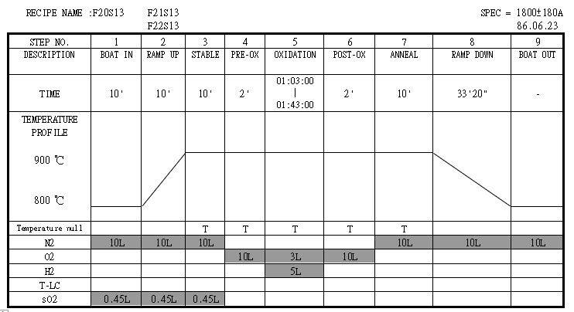
程式結構圖：
Abort 步驟

Slide 6
EDC & RTC
控片及產品之 EDC & RTC data (trends)/比較異常事件中的資料與正常資料

Slide 7
RMS Detail：
溫度設定值
溫度實際值
Check RMS temp step5 溫度未達abort

Slide 8
RMS Detail：
流量設定值
流量實際值
Check RMS flow normal

Slide 9
Discipline 3.執行及驗證暫時防堵對策 Contain the Problem
(Define and implement containment actions to isolate the effect of problem from any internal/external customer until corrective action is implemented)
F20 run S13 step5 low-temp abort
Check: C4 MW: 35A
Setup rework recipe : F20RWK
(1)Copy F20S13
(2)Delete step1~3 sO2
Action:
Assign M/W run F20RWK then check Tox

Slide 10
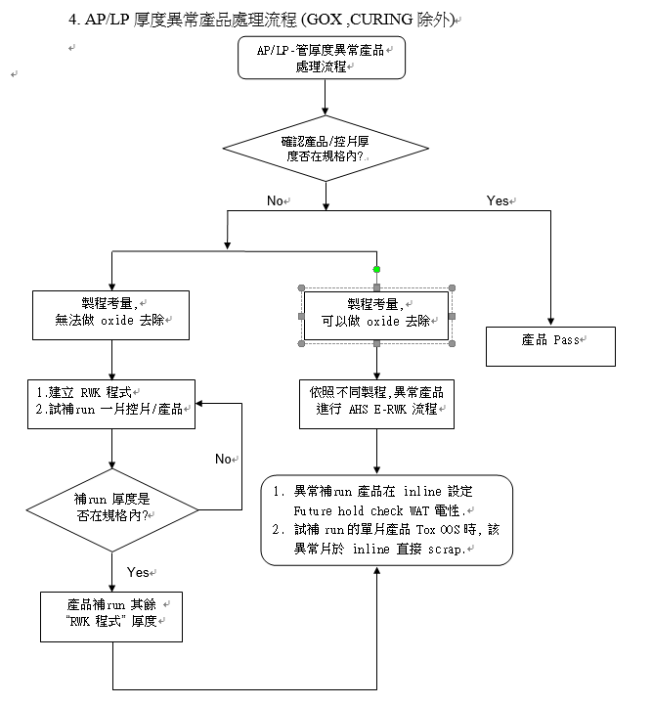
OCAP
貼出此異常事件的 OCAP 處理流程圖, 依此流程所下之決定為….
(OI 在 S210 網頁有 word file)

Slide 11
Discipline 4.定義及驗證真因 (Identify the Root Cause)
(Identify all potential causes which could explain why the problem occurred)
4.1 Non-conformance root cause (defect nature / technical root cause):
a) Failure mechanism:
由 M340 控制 flow 進行氫氧點火程序
T1 (120 secs)
T2 (15 secs)
T3 (22 secs)
Step.4
Step.5 (點火後)
N2
O2
H2
2000 sccm
10000 sccm
3000 sccm
3000 sccm
3000 sccm
5000 sccm
Recipe 設定流量
Recipe 設定流量
T1 時間 Low-temp abort

Slide 12
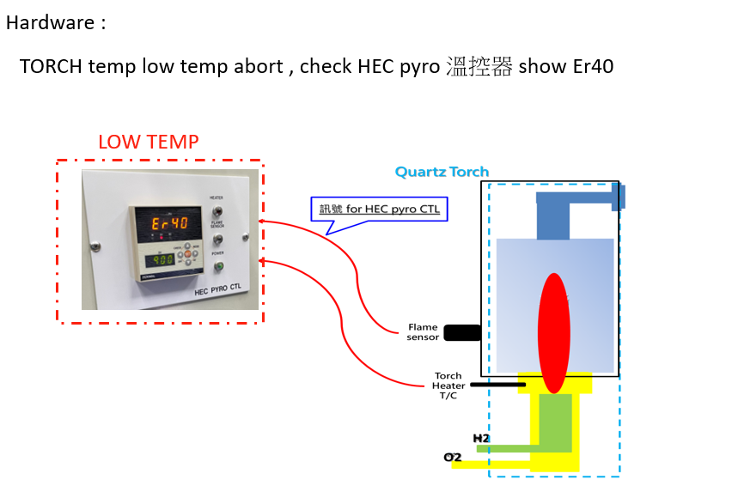
Discipline 4.定義及驗證真因 (Identify the Root Cause)
(Identify all potential causes which could explain why the problem occurred)
4.1 Non-conformance root cause (defect nature / technical root cause):
a) Failure mechanism:
T/C 線路受靜電干擾造成斷路
當下量測讀值達+100V ↑

Slide 13
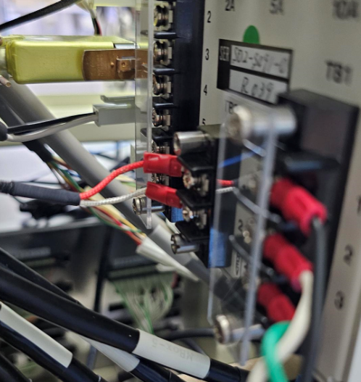
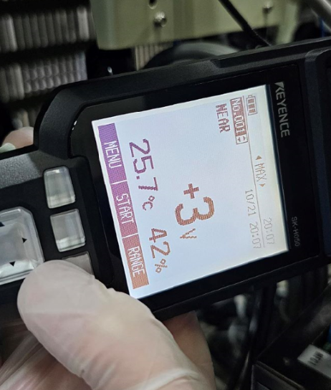
Discipline 4.定義及驗證真因 (Identify the Root Cause)
(Identify all potential causes which could explain why the problem occurred)
4.1 Non-conformance root cause (defect nature / technical root cause):
a) Failure mechanism:
靜電消除液 Clean 後 量測靜電最大值 +3V ok
Test run S13 厚度1787 (control = 1800±90 )data ok PE check release.

Slide 14
Summary
F20 Run S13 step.5 low-temp abort
產品處理:
1. Check MW THK:35A
2. Assign MW do F20RWK then product do F20RWK
機台處理:
1.量測HEC Controller T/C 導線接點處 +10x V 靜電
2.重新壓接接點 並使用靜電消除液 clean 接點重新量測靜電 個位數 V
3. Test run S13 data ok PE check release.

Slide 15
Discipline 4.定義及驗證真因 (Identify the Root Cause)
(Identify all potential causes which could explain why the problem occurred)
4.1 Non-conformance root cause (defect nature / technical root cause):
b) 列出所有可能的原因 (Probable Causes/Factors): Non-conformance
工具 (Tools): 故障樹分析 (Fault Tree Analysis)、魚骨圖 (Fishbone)

Slide 16
Discipline 4.定義及驗證真因 (Identify the Root Cause)
(Identify all potential causes which could explain why the problem occurred)
4.1 Non-conformance root cause (defect nature / technical root cause):
c) 真因驗證 (Root Cause Verification)

Slide 17
Discipline 5.擬定及驗證永久改善對策Choose and verify permanent corrective action (列出各項執行之對策並檢核其對策有效性)
5.1 What was the chosen corrective action to correct the root cause? (Add photo or diagram where applicable.)
Short term :
Long term:

Slide 18
Discipline 5.擬定及驗證永久改善對策Choose and verify permanent corrective action (列出各項執行之對策並檢核其對策有效性)
5.1 What was the chosen corrective action to correct the root cause? (Add photo or diagram where applicable.)

Slide 19
Discipline 5.擬定及驗證永久改善對策Choose and verify permanent corrective action (列出各項執行之對策並檢核其對策有效性)
5.2 Verification of actions effectiveness

Slide 20
Discipline 5.擬定及驗證永久改善對策Choose and verify permanent corrective action (列出各項執行之對策並檢核其對策有效性)
5.2 Verification of actions effectiveness

Slide 21
Discipline 6.實施認永久改善對策Corrective Actions Implementation
6.1 For non-conformance root cause (defect nature / technical root cause):
6.2 For non-detection / escape root cause

Slide 22
Discipline 7.避免再發Prevent Recurrence (Modify System / Document)
7.1 Systemic Actions:

Slide 23
Discipline 7.避免再發Prevent Recurrence (Modify System / Document)

Slide 24
Discipline 7.避免再發Prevent Recurrence (Modify System / Document)
7.2 Corrective Actions Fan-out: (水平展開):

Slide 25
Discipline 8. Congratulate the Team
Thanks for every member helped in this case.
Reviewed and Approved by:

